Slide 1
FLORIDA PRETRIAL RISK ASSESSMENT INSTRUMENT
Katina Bouza & Monique Nagy, Collier County

Slide 2
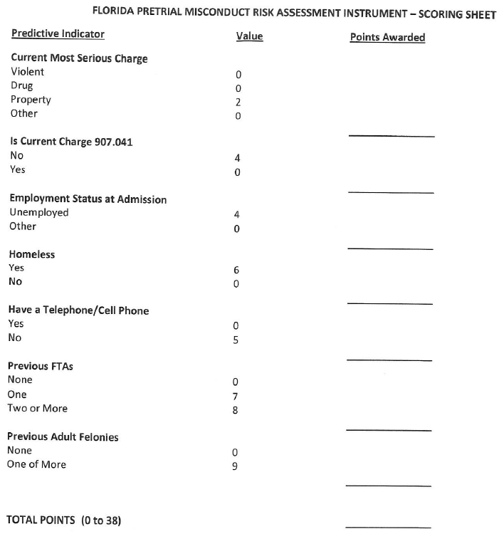
Revalidation of the Risk Assessment Tool in 2021
The following seven factors were identified as having an independent effect on predicting pretrial misconduct:

Slide 3
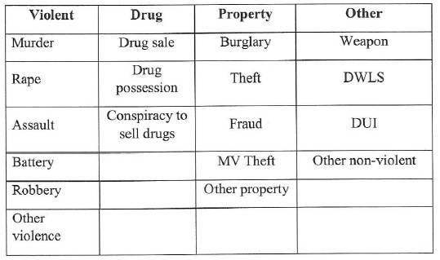
Breakdown of Florida Risk Assessment
“What is the nature of the defendant’s most serious current charge?”

Slide 4
Breakdown of Florida Risk Assessment
“Are any of the defendant’s current charges listed in Florida Statute Chapter 907.041?”

Slide 5
Breakdown of Florida Risk Assessment
“What was the defendant’s employment status at the time of admission into the jail for the current charge?”

Slide 6
Breakdown of Florida Risk Assessment
“Did the defendant have a telephone or cellphone at the time of admission into the jail on the current charge?”

Slide 7
Breakdown of Florida Risk Assessment
“During the 6 months prior to jail admission for the current charge, the person has been homeless.”

Slide 8
Breakdown of Florida Risk Assessment
“What is the number of prior (to jail admission) failures to appear the defendant has had in the past seven years for which a warrant was recorded as being issued and not rescinded?”

Slide 9
Breakdown of Florida Risk Assessment
“What is the number of adult felony adjudications the defendant has had in the past seven years?”

Slide 10
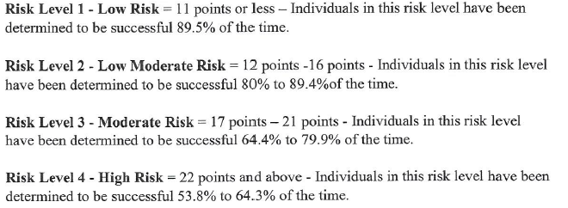
Breakdown of Florida Risk Assessment

Slide 11
2021 Revalidated Risk Assessment

Slide 12
Let’s Practice!
30 YOA
B/F
Burglary-occupied dwelling unarmed; Grand theft $100-$750; Fail to reg conv fel
Unknown employment
Does not have phone
Homeless in your jurisdiction
No previous FTAs
Several previous adult felony convictions from 2020 & 2021 & adult misdemeanor convictions from 2022 & 2023
History of Mental Health Conditions
History of substance abuse

Slide 13
Let’s Practice!
38 YOA
W/M
FTA- DWLSR 2nd
Unemployed
Unknown telephone
Local address
Previous FTAs: Collier 2013; Charlotte 2019; Collier 2021
Several previous adult misdemeanor convictions from 2009, 2014, 2015, 2020, & 2022
No history of mental health conditions
History of substance abuse

Slide 14
Let’s Practice!
43 YOA
W/M
WTA- Sexual Battery
Employed
Has cell phone
Local address
Previous FTAs: Collier 2012
No previous adult felony convictions; previous adult misdemeanor convictions from 2006 & 2010
No history of mental health conditions
No history of substance abuse

Slide 15
Let’s Practice!
68 YOA
W/M
Possess cocaine; Drive w/DL from other state when FL DL susp/ Posess paraphernalia
Retired
Has telephone
Resides in Indiana
No Previous FTAs
Several previous adult felony convictions from 2017, 2022, & 2023
No history of mental health conditions
No history of substance abuse

Slide 16
Let’s Practice!
59 YOA
W/F
VOCP- Possess cocaine
Unemployed
Does not have phone
Resides in California
One previous FTA: Collier 2021
No previous adult felony convictions
No history of mental health conditions
History of substance abuse

Slide 17
Let’s Practice!
36 YOA
B/F
Battery on 65 YOA or older
Employed
Has telephone
Resides within your Judicial Circuit
Previous FTAs: Hendry: 2015, 2016
No previous adult felony convictions
No history of mental health conditions
No history of substance abuse

Slide 18
Let’s Practice!
46 YOA
W/M
Possess stolen DL; False info to LEO; Fugitive frm just-Manatee-VOP x2; Petit theft; RAWOV
Employed
Has telephone
Resides within your Judicial Circuit
Previous FTAs: Georgia 2019; Manatee 2022
Several previous adult misdemeanor convictions from 2016, 2017, 2019, & 2020 & adult felony convictions from 2010, 2012 & 2013
No history of mental health conditions
History of substance abuse

Slide 19
Let’s Practice!
37 YOA
W/M
FTA- Grand theft $750- $5000
Unemployed
Does not have telephone
Resides locally
Previous FTAs: Broward 2022, Collier 2023, Broward 2023
One previous adult felony conviction from 2019
No history of mental health conditions
History of substance abuse

Slide 20
Let’s Practice!
18 YOA
B/M
NVDL
Student
Has cell phone
Resides in another Florida county
No previous FTAs
No previous adult felony convictions
No history of mental health conditions
No history of substance abuse

Slide 21
Let’s Practice!
48 YOA
W/M
Trafficking Fentanyl
Employed
Does not have phone
Resides locally
Previous FTAs: Alachua 2016, Leon 2017
Several previous adult misdemeanor convictions from 2015, 2017, 2018, & 2022, and no previous adult felony convictions
No history of mental health conditions
History of substance abuse

