Slide 1
HOUSE BILL 1627
APPF Training February 2024
PRETRIAL RELEASE AND DETENTION
Katina Bouza and Monique Nagy, Collier County

Slide 2
Approved by the Governor May 1, 2023
Effective since January 1, 2024

Slide 3
Makes changes to the following Florida Statutes:
903.011 | Pretrial Release
903.047 | Conditions of pretrial release
903.0471 | Violation of Pretrial Release
907.041 | Pretrial Detention and Release

Slide 4
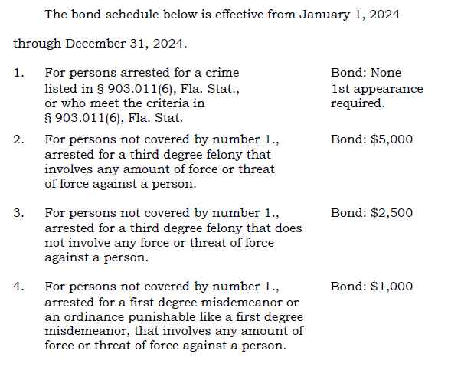
Supreme Court created a uniform bond schedule for bail eligible charges
903.011 Pretrial Release

Slide 5
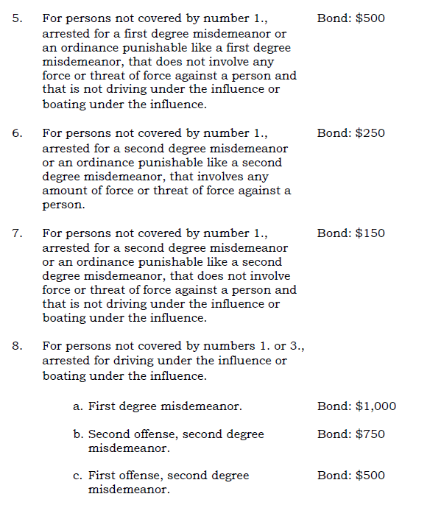
Supreme Court created a uniform bond schedule for bail eligible charges
903.011 Pretrial Release

Slide 6
Supreme Court created a uniform bond schedule for bail eligible charges
903.011 Pretrial Release
The chief judge of a judicial circuit cannot establish a bond schedule that sets a lower bond amount
The chief judge may petition the Supreme Court for approval of bond schedule that sets a lower bond amount
The chief judge may establish a local bond schedule that increases the amount of the bond schedule without asking for approval

Slide 7
What the Supreme Court must consider when setting the amount or reviewing a petition for a deviation
903.011 Pretrial Release
The amount necessary to protect the community from the risk of physical harm, to assure the presence of the accused at trial, and to protect the integrity of the judicial process
The uniform bond schedule shall not bind a judge in an individual case who is conducting a first appearance or bail determination

Slide 8
Additional requirements of 903.011
An accused cannot be released before their first appearance hearing, if any of the criteria on the following charts exist…

Slide 9
It is a felony arrest and they were on pretrial release, probation, or community control
At the time of the arrest they were designated as a sexual offender or sexual predator
They were previously sentenced under certain enhancement statutes (e.g. prr, hvfo)
They were arrested 3 or more times in the last 6 months
The arrest is for a capital felony, life felony, 1st degree felony or 2nd degree felony
The arrest is a homicide (attempt, solicitation or conspiracy included)
The arrest is for certain riot, felony battery, dv by strangulation, dv, stalking, mob intimidation, assault or battery on a LEO (or juvi PO or detention staff), health services personnel, assault or battery on a person 65 years of age or older, robbery, burglary, carjacking, or resisting an officer with violence
The arrest is for kidnapping, false imprisonment, human trafficking, or human smuggling
The arrest is for possession of a firearm or ammo by a felon VCC, or person subject to certain dv injunctions
The arrest is for numerated sex offenses

Slide 10
The arrest is for a numerated offenses against the elderly or disabled
The arrest is for child abuse or aggravated child abuse
The arrest is for arson or numerated riot offenses
The arrest is for escaping or numerated tampering offenses
The arrest is for numerated gang offenses
The arrest is for trafficking in controlled substances
The arrest is for racketeering
The arrest is for failure to appear
The arrest is for violating a protective injunction

Slide 11
Court must consider factors in 903.046(2) when imposing nonmonetary conditions.
Such nonmonetary conditions require the defendant to:
Maintain employment
Maintain or commence an educational program
Abide by specified restrictions (associations, residence, travel)
Report on a regular basis
Comply with specified curfew
Refrain from possessing a firearm, destructive device, or other dangerous weapon.
Refrain from excessive use of alcohol, or any use of a narcotic drug or other controlled substance without a prescription from a licensed medical practitioner.
Undergo available medical, psychological, psychiatric, mental health, or substance abuse evaluation and follow all recommendations, including treatment for drug or alcohol dependency, and remain in a specified institution, if required for that purpose.
Return to custody for specified hours following release for employment, school, or other limited purposes.
Any other condition that is reasonably necessary to assure the appearance of the defendant at subsequent proceedings and to protect the community against unreasonable danger of harm.
903.047 Conditions of Pretrial Release

Slide 12
The only change to this statute is the addition underlined below:
A court may, on its own motion, revoke pretrial release and order pretrial detention if the court finds probable cause to believe that the defendant committed a new crime while on pretrial release or violated any other condition of pretrial release in a material respect.
903.0471 Violation of Condition of Pretrial Release

Slide 13
There has been additional dangerous crimes added:
For Manslaughter, it’s including DUI manslaughter and BUI manslaughter
Trafficking in any controlled substance
Extortion
Written threats to kill
Any person arrested for a dangerous crime may not be granted nonmonetary pretrial release at first appearance if the court has determined there is probable cause to believe the person has committed the offense. The discretion of the judge being able to grant nonmonetary bond for dangerous crimes has been removed. They no longer can place a defendant that’s been arrested on a dangerous crime on nonmonetary bond.
907.041
Pretrial Detention and Release

Slide 14
The state attorney or the court shall motion for pretrial detention to those defendants:
arrested for a dangerous crime that is a capital felony, a life felony or a felony of the first degree
Court determines there is probable cause to believe that the defendant committed the offense
Court must order Pretrial Detention if:
It finds a substantial probability that the defendant committed the offense
based on the defendant’s past and present patterns of behavior
consideration of the criteria in s. 903.046
Any other relevant facts that no conditions of release or bail will protect the community from risk of physical harm, ensure the presence of the defendant at trial, or assure the integrity of the judicial process,
907.041
Pretrial Detention and Release

Slide 15
Pretrial Detention Hearing must be within 5 days after the defendant’s fiat appearance hearing or if there is no first appearance hearing, within 5 days after the defendant’s arraignment
If a state attorney files a motion for pretrial detention under paragraph (c), the pretrial detention hearing must be held within 5 days after the filing of such motion.
The defendant may be detained pending the completion of the pretrial detention hearing.
A party may motion for a pretrial detention order to be reconsidered at
any time before a defendant’s trial
907.041
Pretrial Detention and Release

Slide 16
What does this all mean?
FL is heading in the opposite direction of NY and California, who have initiated criminal justice reforms (i.e. elimination of bail).
Critics feel this change will disproportionately hurt minorities and the poor.
Preventing release before first appearance for the enumerated offenses/situations will likely result in higher incarceration and bond amounts across the board.
Motions will be granted for Pretrial Detention more often, which will also result in higher incarceration.

Slide 17
Adopted the uniform Statewide Bond schedule with the below additions:
Ensuring compliance with the requirements of the Jessica Lunsford Act
Ensuring compliance with the requirements of the Anti-Murder Act
Bond amounts remained the same as the Uniform Bond Schedule
20th Judicial Circuit Bond Schedule

Slide 18
Questions, comments, observations

