Slide 1
FLORIDA PRETRIAL RISK ASSESSMENT INSTRUMENT

Slide 2
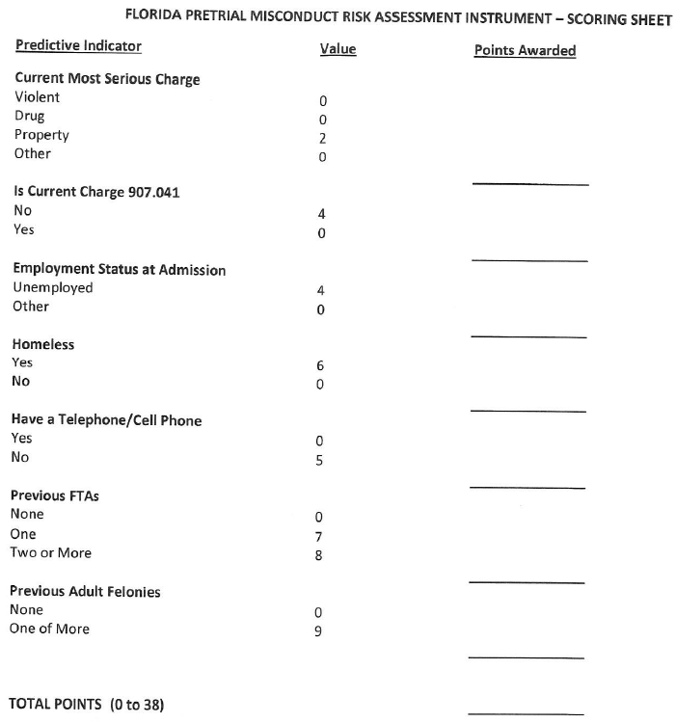
Revalidation of the Risk Assessment Tool in 2021
The following seven factors were identified as having an independent effect on predicting pretrial misconduct:

Slide 3
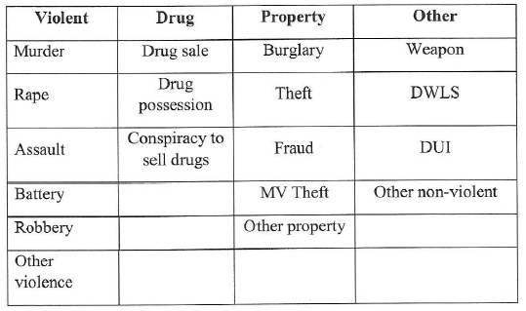
Breakdown of Florida Risk Assessment
“What is the nature of the defendant’s most serious current charge?”

Slide 4
Breakdown of Florida Risk Assessment
“Are any of the defendant’s current charges listed in Florida Statute Chapter 907.041?”

Slide 5
Breakdown of Florida Risk Assessment
“What was the defendant’s employment status at the time of admission into the jail for the current charge?”

Slide 6
Breakdown of Florida Risk Assessment
“Did the defendant have a telephone or cellphone at the time of admission into the jail on the current charge?”

Slide 7
Breakdown of Florida Risk Assessment
“During the 6 months prior to jail admission for the current charge, the person has been homeless.”

Slide 8
Breakdown of Florida Risk Assessment
“What is the number of prior (to jail admission) failures to appear the defendant has had in the past seven years for which a warrant was recorded as being issued and not rescinded?”

Slide 9
Breakdown of Florida Risk Assessment
“What is the number of adult felony adjudications the defendant has had in the past seven years?”

Slide 10
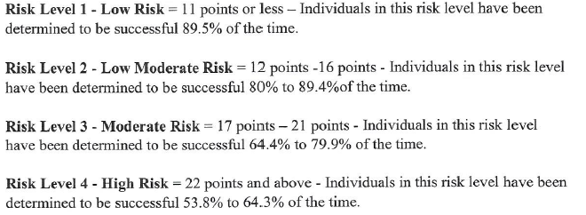
Breakdown of Florida Risk Assessment

Slide 11
CCSO’s Version of the 2021 Revalidated Risk Assessment

