Slide 1
the Baker Act
Mary Ann Guerra, RN
Chief Clinical Officer

Slide 2
Learning Objectives
Participants will be able to verbalize understanding of:
The History and Intent of the Baker Act
Criteria for Voluntary and Involuntary Baker Act Admission
What People Experience When Placed Under a Baker Act
Multidisciplinary Treatment Team Model
Evidenced Based Practices
Continued Involuntary Placement and Court Related Proceedings
Discharge Planning and Improving Outcomes

Slide 3
HISTORY OF THE BAKER ACT
1963- President Kennedy submitted the first presidential message and engaged Congress to pass the Community Mental health Centers (CMHC)Act.
In 1971, the Florida Legislature passed into law the Florida Mental Health Act,
which went into effect July 1 of the following year.
Referred to as the “Baker Act,” named after Maxine Baker, a former State Representative from Miami who sponsored the Act.
Before the Baker Act was enacted, a person could be placed in a state hospital if
three people signed affidavits and secured the approval of a county judge.

Slide 4
INTENT OF THE BAKER ACT
The Act intended to:
Encourage voluntary admissions as opposed to involuntary (when the person was competent to consent).
Separate the process of hospitalization from the process of legal incompetency.
Increase community care of persons with mental illnesses and to facilitate persons’ return to normal community life.

Slide 5
BAKER ACT CRITERIA
There is reason to believe an individual has a mental illness, and because of their mental illness:
The individual has refused voluntary examination, or they are unable to determine for themselves that examination is necessary and
Without care or treatment, they may suffer from personal neglect or refuse to care for themselves, which presents a threat of substantial harm to their well-being; or
There is a substantial likelihood that without care or treatment, the individual will cause harm to themselves or others in the near future.

Slide 6
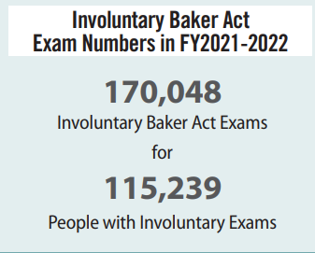
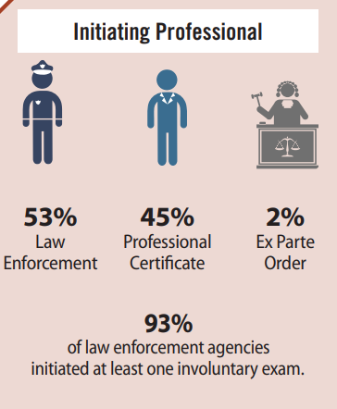
https://www.myflfamilies.com/crisis-services/baker-act

Slide 7
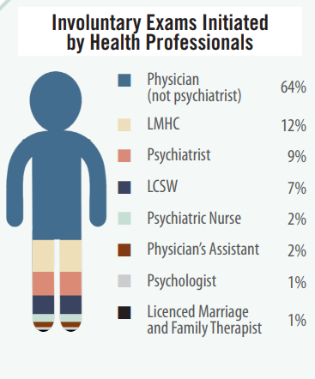
WHO CAN INITIATE A BAKER ACT?
Source: Baker Act Reporting Center Fiscal Year 2021-2022 Infographic
Allows families, health care providers, law enforcement officers, or other professionals to seek emergency mental health services for individuals who are at imminent risk of harming themselves or others or unable to care for themselves because of mental illness AND who are unable to determine their own treatment needs.
Families can work with their local courts and Community Behavioral Health Centers to learn about the Exparte Baker Act process.

Slide 8
Designated receiving facilities
Most voluntary and involuntary Baker Act services are delivered in a designated receiving facility. Designated receiving facilities (DRFs) also provide voluntary services.
DRFs provide crisis services, suicide prevention, and stabilization services 24/7. Many partners with the 988 Suicide Prevention Lifeline system and have mobile crisis teams and/or mental health intervention units that coordinate with their local partners, LEO, and hospital systems.
Receiving facilities are designated as either a public or private facility. The designation of receiving facilities as public or private facilities is determined by how the facility is funded and affects how individuals can be transferred between facilities.

Slide 9
Crisis Stabilization Units (CSU)
While some public receiving facilities are hospitals, the majority are licensed as CSUs.
CSUs provide services to individuals who are insured, uninsured and underinsured.
A CSU that serves adults may be licensed for a maximum of 30 beds, while those serving minors may be licensed for a maximum of 20 beds.
CSUs cannot exceed capacity by more than 10 percent. Capacity cannot be exceeded for longer than three (3) consecutive days and no more than seven (7) days in 30 days.

Slide 10
Transfer of Baker Acts requiring Medical Clearance
Transfer of individuals referred from non-designated hospitals (typically ERs) after examination or treatment of an emergency medical condition within 12 h
The 72-hour involuntary examination period shall not be exceeded.
Form- “Request for Involuntary Examination After Stabilization of Emergency Medical Condition” will be sent to a designated receiving facility.

Slide 11
INITIAL Clinical ASSESSMENT PROCESS
A person referred under voluntary or involuntary status receives a clinical triage and psychosocial assessment from a trained clinician, typically within the first several hours from arrival to a Baker Act Receiving Facility.
The Clinician and/or a designated trained staff provides an orientation to the individual, obtains collateral information, assists the person to feel safe, and explains the Baker Act process.
The Clinician is trained in MH/SUD Crisis Assessment, Crisis Intervention, Suicide Risk Assessment, Violence Risk Assessment, DSM5-TR, and Safety Planning, among other Evidenced-based Practices.

Slide 12
INVOLUNTARY EVALUATION PROCESS- COLLATERAL AND Naming A REPRESENTATIVE
When individuals are transported by an LEO, the transportation form and affidavits become part of the assessment process and are reviewed by the Provider.
01
The Patient/patient Retains Specific Civil Rights, including the Right to Name a Representative
02
If the Patient/patient cannot name a representative, the facility will name one for the person based on a required priority list set forth by the Statute.
03

Slide 13
BEHAVIORAL HEALTHCARE TECHNICIANS
Behavioral Health Technicians (BHTs) are integral to the treatment team. BHTs are critical in the patient’s admission, treatment, and daily experience. BHTs continuously interact with patients and provide crisis support and life-space interactions.
As part of the admission process, BHTs assist in orienting the patient to their environment and facilitating the admission process.
Admission includes educating the patient on their rights, assisting the patient to be comfortable in the environment and assigning a room, supporting ADLs, engaging the patient within the milieu, and supporting the patient to participate in the unit’s daily activity schedule.
BHTs take daily vital signs, support practitioner rounds, implement groups and outdoor times, serve patient meals, report concerns to the nursing staff, monitor for safety, complete frequent rounds, 1:1,15-minute observations, etc.
.

Slide 14
Nursing assessment
Completed by a Registered Nurse
Best practice- upon admission and required before 24 hours.
Head-to-toe assessment
Vital Signs/Pain
Medical issues, History, Allergies, Infection, Medication List, Diet.
Chronic Illnesses: Thyroid Disease, COPD, Hypertension, Diabetes, etc.
Orders, PRN medications, Immediate Needs.

Slide 15
Determination of competence to provide informed consent for treatment
An individual is often deemed clinically incompetent by a physician when:
They experience an acute or chronic condition that significantly impairs their ability to make rational decisions.
This could be directly related to a mental health condition, such as an episode of psychosis, or a more generalized medical or biological condition, such as an advanced neurocognitive disorder, such as Alzheimer’s disease.
If an individual is deemed incompetent to provide express and informed consent and does not already have a substitute decision-maker identified through a court order, the facility administrator must promptly file a petition with the court for both involuntary services and the appointment of a guardian advocate.

Slide 16
Emergency Treatment Orders
Express and informed consent for individuals on voluntary or involuntary status may be temporarily overridden with an emergency treatment order (ETO). A physician may order an ETO in select documented cases where immediate action is needed to stop current behaviors that pose a significant physical threat to the individual or others at the facility.
ETO can be administered to an individual on either voluntary or involuntary status and can impact an individual’s legal status or decision-making ability.
If an individual is administered two (2) ETOs within seven (7) days, the facility must file a petition with the court to appoint a guardian advocate to provide express and informed consent. If the individual is on voluntary status, he or she must also be transferred to involuntary status.

Slide 17
examinations
Physical Exam:
Each person who remains at a receiving or treatment facility for more than 12 hours shall be given a physical examination by a health practitioner authorized by law to give such examinations within 24 hours after arrival.
Psychiatric Evaluation- Typically within 24 hours, and includes competency assessment:
Medical history, including psychiatric history, developmental abnormalities, physical or sexual abuse or trauma, and substance abuse; laboratory results, mental status examination; diagnosis, ruling out non-psychiatric causes of presenting symptoms of abnormal thought, mood or behaviors; Current medications and dosages, family history, suicide risk assessment, violence risk assessment, etc.
Daily Rounds: Psychiatrists and/or PMHNPs-BC can perform follow-up evaluations.

Slide 18
Continued involuntary placement
A patient may be retained by a facility or involuntarily placed in a treatment facility upon the recommendation of the facility’s administrator where the patient has been examined.
The recommendation must be supported by the opinion of a psychiatrist and the second opinion of a clinical psychologist or another psychiatrist, both of whom have personally examined the patient within the preceding 72 hours.
If the administrator certifies that a psychiatrist or clinical psychologist is not available to provide the second opinion, the second opinion may be provided by a licensed physician who has postgraduate training and experience in the diagnosis and treatment of mental illness or by a psychiatric nurse.

Slide 19
Holistic and integrated treatment
A multi-disciplinary treatment approach is best to support Baker Act services in CSUs and Psychiatric Hospitals.
The Psychiatrist is the leader and/or APN in the absence of the Psychiatrist.
Coordination and integration of services between providers, stakeholders, and systems is essential.
Multiple allied therapies often support the patient’s wellness and improvement.
Music therapy, group therapy, peer support, occupational therapy, behavioral interventions, pet therapy, exercise and fitness, nutritional consultations, etc., are integral to reaching the best outcomes and decreasing the need for continued involuntary treatment.
Long-acting medications, Opioid Assisted Treatment, and other EBPs are considered best practices.

Slide 20
Stabilization and POST-Discharge
A patient will be discharged when Baker Act criteria are no longer met.
Individuals may be transferred to other levels of care, inpatient or outpatient, with multiple services and programs involved.
Examples include SUD Residential Treatment (Voluntary), Short Term Residential Treatment Centers (SRTs) (Involuntary), and State hospitals (for Involuntary patients).
Involuntary Assisted Outpatient Treatment is another important branch of the Baker Act that the psychiatrist can request as part of the court recommendations.

Slide 21
Discharge planning and case management
Although not part of the mandatory minimum staffing patterns, most BA Receiving facilities, Psych Hospitals, and CSUs hire clinicians who provide discharge planning services. They may have a bachelor’s degree in Social Work or other credentials such as a master’s degree.
The DC Planner role includes care coordination, collateral information gathering, family/SO engagement, obtaining ROIs, meeting with the patient to engage in treatment and DC Planning, arranging family meetings, application completion, referral and Linking to resources and services, and treatment plan development/review.

Slide 22
discharge PlANNING services
7-day Clinical and Medication Management Appointments
Colombia Suicide Severity Rating Scale(C-SSRS)
Discharge Plans and Instructions
6-Step Safety Plan
Counseling on Access to Lethal Means- Medication Safety, Weapons Removal
Resources: NAMI, Transportation, Housing, AA, Case Management, Care Coordination,
Warm Hand-offs, Step-down.

Slide 23
QUESTIONS
Thank you!

